Slide 1
Hotel Reservation Analysis
Presented by :- Alim kamruddin chogle
Data analst intern
batch :- mip-da-10

Slide 2

Table of content
Introduction
Problem Statement
Data Description
Objectives
Data Exploration and Analysis
Conclusion

Slide 3
Introduction
The hospitality industry thrives on understanding guest preferences, booking trends, and operational metrics to deliver exceptional guest experiences. In this project, we delve into a comprehensive analysis of a hotel reservations dataset using SQL, aiming to uncover valuable insights that can inform strategic decisions and enhance operational efficiencies.

Slide 4
Dataset Overview
The dataset comprises detailed information on hotel reservations, including booking IDs, guest demographics (number of adults and children), reservation specifics (room type, meal plan), booking dynamics (lead time), arrival dates, market segments, average room prices, and booking statuses. Each entry represents a unique reservation, offering a wealth of data for analysis.

Slide 5
Booking_ID: A unique identifier for each hotel reservation.
no_of_adults: The number of adults in the reservation.
no_of_children: The number of children in the reservation.
no_of_weekend_nights: The number of nights in the reservation that fall on
weekends.
no_of_week_nights: The number of nights in the reservation that fall on
weekdays.
type_of_meal_plan: The meal plan chosen by the guests.
room_type_reserved: The type of room reserved by the guests.
lead_time: The number of days between booking and arrival.
arrival_date: The date of arrival.
market_segment_type: The market segment to which the reservation
belongs.
avg_price_per_room: The average price per room in the reservation.
booking_status: The status of the booking.

Slide 6
Objectives
Quantitative Analysis: Determine the total number of reservations, average lead time, and distribution of reservations over time to identify peak booking periods.
Guest Preferences: Analyze popular meal plans and room types preferred by guests to understand booking trends and optimize inventory management.
Market Segmentation: Identify the most common market segments booking the hotel, analyze their contribution to revenue, and uncover trends in booking behavior across different segments.
Operational Insights: Explore the impact of children on reservation characteristics, such as average room price and length of stay, to tailor service offerings and improve guest satisfaction.

Slide 7
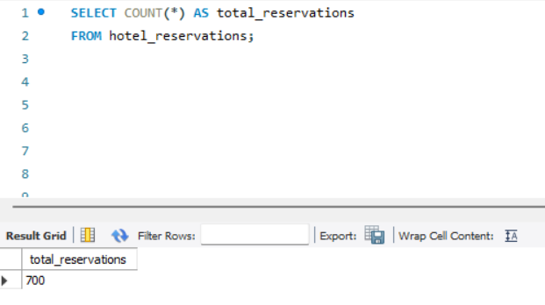
Data Exploration and Analysis
What is the total number of reservations in the dataset?
Inference :- total reservation is 700

Slide 8
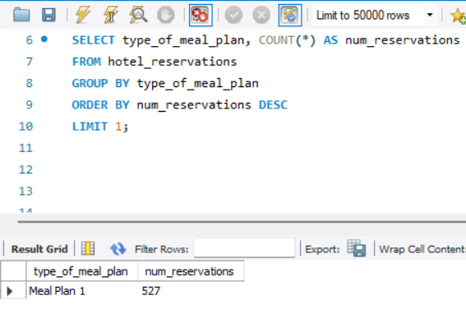
Which meal plan is the most popular among guests?
Inference: Meal plan 1 is reserved for 527 peoples

Slide 9
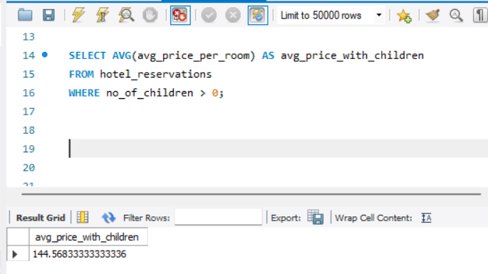
What is the average price per room for reservations involving children?
Inference: Average price of Hotel room 144.56 with children.

Slide 10
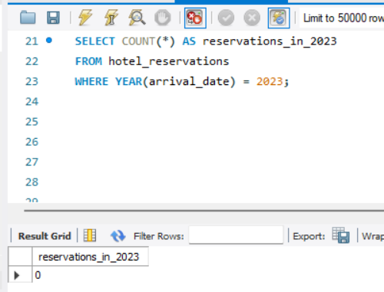
How many reservations were made for the year 20XX (replace XX with the desired year)?
Inference : there is no reservation in year 2023.

Slide 11
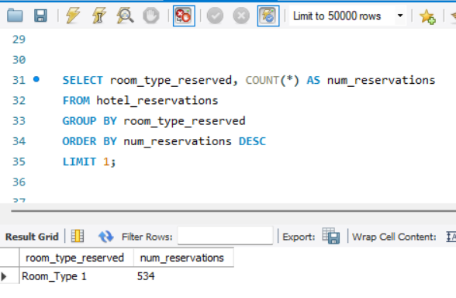
What is the most commonly booked room type?
Inference : most commonly room_type 1 is booked 534 times.

Slide 12
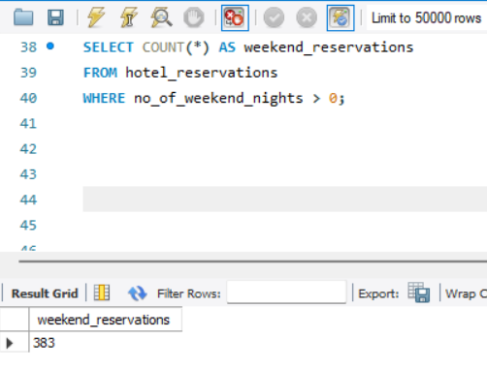
How many reservations fall on a weekend (no_of_weekend_nights > 0)?
Inference : 383 reservations on Weekends .

Slide 13
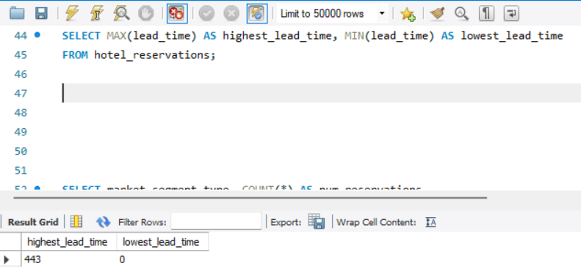
What is the highest and lowest lead time for reservations?
Inference : highest lead time is 443 and no lowest lead time.

Slide 14

What is the most common market segment type for reservations?
Inference : most market segment type for reservation is online and 518 reservation gets online

Slide 15
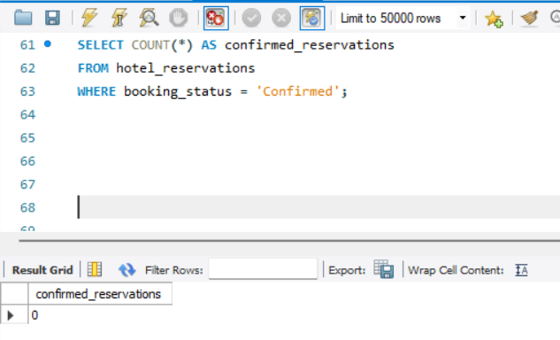
How many reservations have a booking status of "Confirmed"?
Inference : no reservations were confirmed .

Slide 16
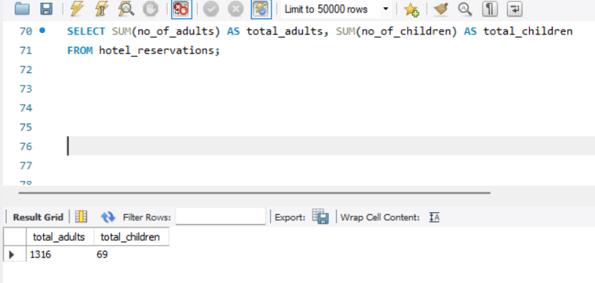
What is the total number of adults and children across all reservations?
Inference : Total Adults are 1316 and children 69 across all reservation.

Slide 17
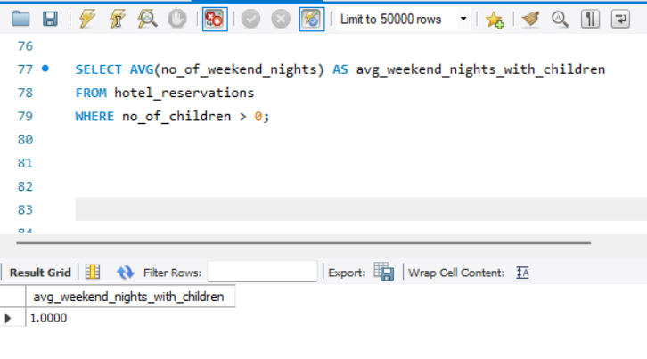
What is the average number of weekend nights for reservations involving children?
Inference : average number of weekend night for reservations involving children is 1.

Slide 18

How many reservations were made in each month of the year?
Inference : 700 reservation in one month.

Slide 19
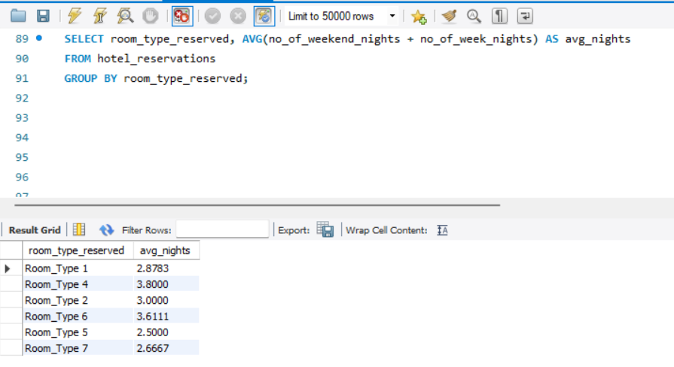
What is the average number of nights (both weekend and weekday) spent by guests for each room type?
Inference : Type 1 has average night of 2.8, Type 4 has average night of 3.8,Type 2 has average night of 3, Type 6 has average night of 3.6, Type 5 has average of night 2.5 and Type 7 has average night of 2.6

Slide 20
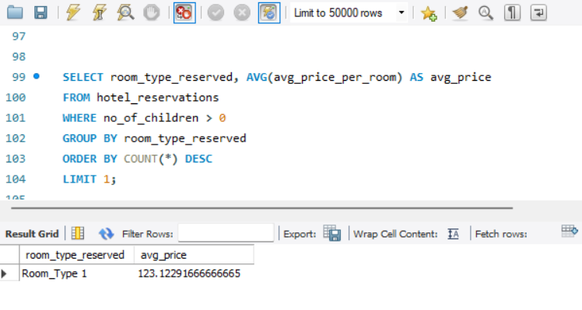
For reservations involving children, what is the most common room type, and what is the average price for that room type?
Inference : average price for that room type involving children is 123.12.

Slide 21
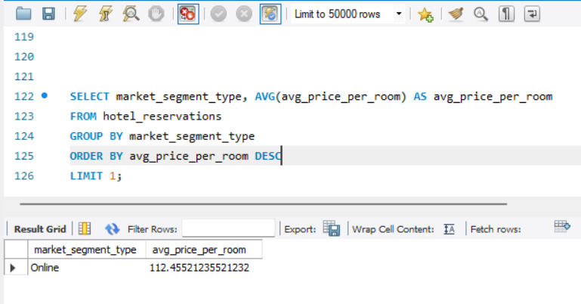
Find the market segment type that generates the highest average price per room.
Inference : market segment type is online and highest average price per room is 112.45.

Slide 22
Conclusion
Through this project, we aim to demonstrate the value of data-driven decision-making in the hospitality industry. By leveraging SQL for comprehensive data analysis, we seek to empower hotel management with actionable insights that drive strategic decision-making, operational efficiency, and ultimately, superior guest experiences.

